Slide 1
CFGs and PCFGs
(Probabilistic) Context-Free Grammars

Slide 2
A phrase structure grammar
S → NP VP
VP → V NP
VP → V NP PP
NP → NP NP
NP → NP PP
NP → N
NP → e
PP → P NP
people fish tanks
people fish with rods
N → people
N → fish
N → tanks
N → rods
V → people
V → fish
V → tanks
P → with

Slide 3
Phrase structure grammars = context-free grammars (CFGs)
G = (T, N, S, R)
T is a set of terminal symbols
N is a set of nonterminal symbols
S is the start symbol (S ∈ N)
R is a set of rules/productions of the form X → γ
X ∈ N and γ ∈ (N ∪ T)*
A grammar G generates a language L.
Notes:
γ is a sequence of terminals and/or nonterminals (possibly an empty sequence)

Slide 4
Phrase structure grammars in NLP
G = (T, C, N, S, L, R)
T is a set of terminal symbols
C is a set of preterminal symbols
N is a set of nonterminal symbols
S is the start symbol (S ∈ N)
L is the lexicon, a set of items of the form X → x
X ∈ P and x ∈ T
R is the grammar, a set of items of the form X → γ
X ∈ N and γ ∈ (N ∪ C)*
By usual convention, S is the start symbol, but in statistical NLP, we usually have an extra node at the top (ROOT, TOP)
We usually write e for an empty sequence, rather than nothing
Notes:
γ is a sequence of terminals and/or nonterminals (possibly an empty sequence)

Slide 5
A phrase structure grammar
S → NP VP
VP → V NP
VP → V NP PP
NP → NP NP
NP → NP PP
NP → N
NP → e
PP → P NP
people fish tanks
people fish with rods
N → people
N → fish
N → tanks
N → rods
V → people
V → fish
V → tanks
P → with

Slide 6
Probabilistic – or stochastic – context-free grammars (PCFGs)
G = (T, N, S, R, P)
T is a set of terminal symbols
N is a set of nonterminal symbols
S is the start symbol (S ∈ N)
R is a set of rules/productions of the form X → γ
P is a probability function
P: R → [0,1]
A grammar G generates a language model L.
Notes:
P gives the probability of each rule.

Slide 7

A PCFG
S → NP VP 1.0
VP → V NP 0.6
VP → V NP PP 0.4
NP → NP NP 0.1
NP → NP PP 0.2
NP → N 0.7
PP → P NP 1.0
N → people 0.5
N → fish 0.2
N → tanks 0.2
N → rods 0.1
V → people 0.1
V → fish 0.6
V → tanks 0.3
P → with 1.0
[With empty NP removed so less ambiguous]
Notes:
Clipart: http://www.wpclipart.com/animals/aquatic/fish/_happy_fish.png.html
Public domain.

Slide 8
The probability of trees and strings
P(t) – The probability of a tree t is the product of the probabilities of the rules used to generate it.
P(s) – The probability of the string s is the sum of the probabilities of the trees which have that string as their yield
P(s) = Σ_{j} P(s, t) where t is a parse of s
= Σ_{j} P(t)

Slide 9
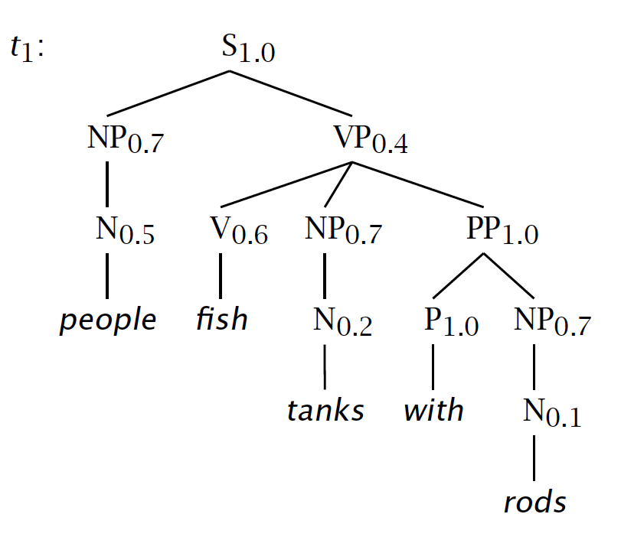

Slide 10
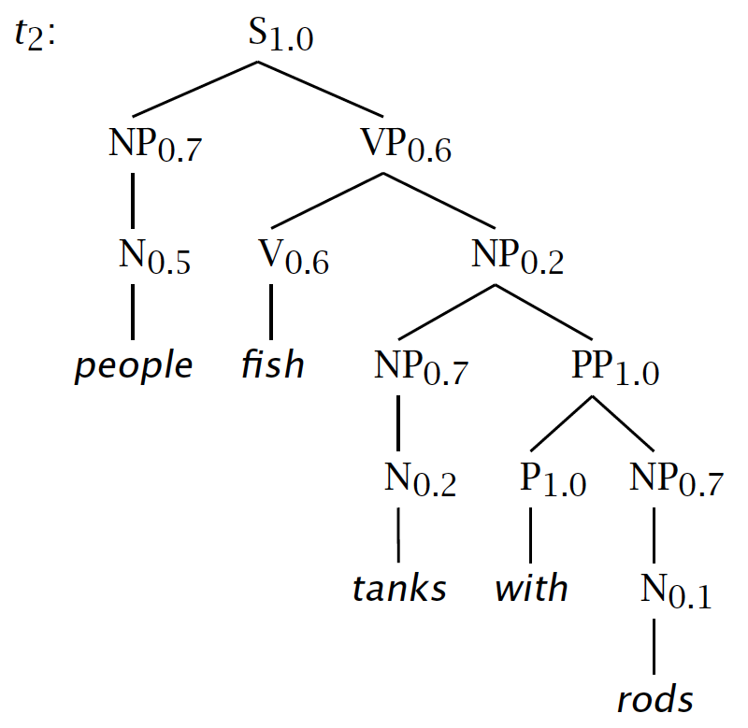

Slide 11
Tree and String Probabilities
s = people fish tanks with rods
P(t₁) = 1.0 × 0.7 × 0.4 × 0.5 × 0.6 × 0.7
× 1.0 × 0.2 × 1.0 × 0.7 × 0.1
= 0.0008232
P(t₂) = 1.0 × 0.7 × 0.6 × 0.5 × 0.6 × 0.2
× 0.7 × 1.0 × 0.2 × 1.0 × 0.7 × 0.1
= 0.00024696
P(s) = P(t₁) + P(t₂)
= 0.0008232 + 0.00024696
= 0.00107016
Verb attach
Noun attach

Slide 12
Notes:
Say that VP is 3 1/3 more times more likely because it’s 0.4 vs. 0.6 x 0.2
Say how you might think how this makes PCFGs very sensitive to how flat or deep trees are. We’ll return to that.

Slide 14
CFGs and PCFGs
(Probabilistic) Context-Free Grammars

